Slide 1


How to Make a Retro Game
Ryan Young, Natalie Haney, Haniel Villarreal, Jaehyun Na

Slide 2
Who Are We?
Ryan Young -
Senior in Data Science/Analytics
Looking towards masters in AI and/or a second bachelors in Environmental Science/an environmental conservation field.
Natalie Haeny-
Senior in Software Development
Hoping to continue my understanding of java and learn new languages like C# and JavaScript.
Haniel Villarreal -
Sophomore in Systems and Security
Aspiring to master the ability to provide protection to some of companies greatest digital assets
Jaehyun Na-
Sophomore in Software Development
Wants to be a Developer

Slide 3
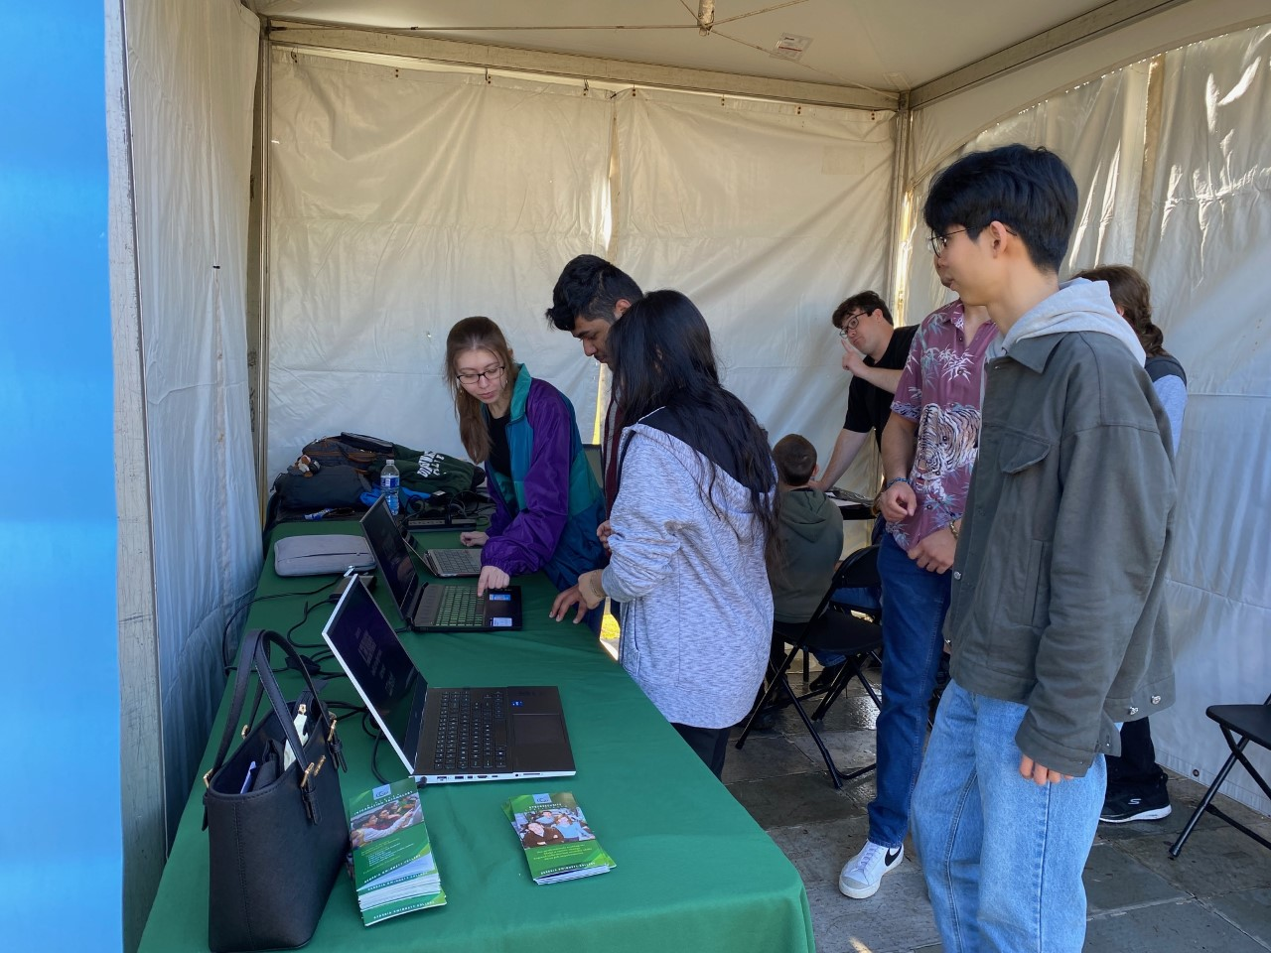
What is Tap?
Tap or STEC4800, is an ITEC elective focused on helping students improve their confidence in programming, problem-solving,leadership skills and working with others.
Assigned teams are expected to create an educational technology-based demo project (mostly demonstrated by making video games or web pages) and the tutorial for IT outreach.
By making these projects students can feel inspired to be able to create something themselves.

Slide 4
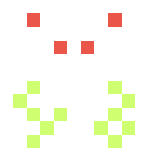
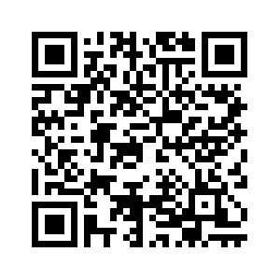

Pre-survey
Please scan the QR code and take our pre-survey!

Slide 5
Downloading Processing
Processing should already be installed on school computers, but if you want the most recent version for your personal computer, go to:
https://processing.org/download
Go to your downloads folder, extract the zip file to your desired location and run the processing.exe application to open the sketchbook.

Slide 6
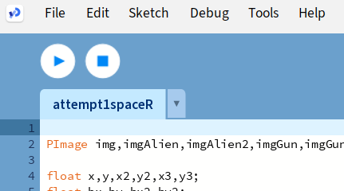
Setting up our game
After opening up processing, one more step must be done in order to run our game.
After clicking on Sketch a drop down menu should appear.
Click on “Add File…”
Finally there should be 7 png files to individually add into the game.
The game should be all ready now!

Slide 7
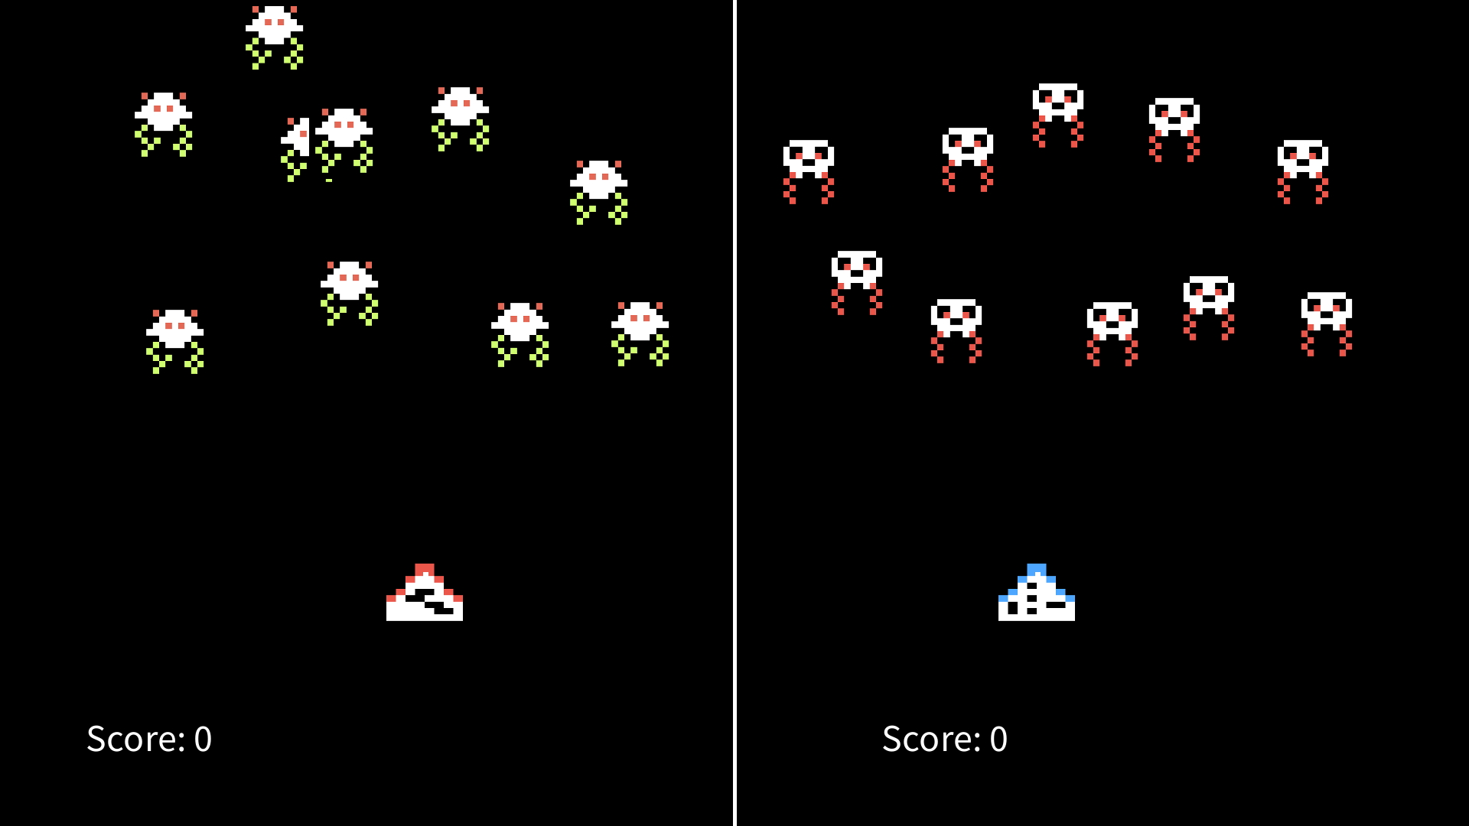
Our project
Our group worked together to develop our own take on the arcade game, Space Invaders.
Our game incorporates the same retro style of the original while adding new features like our multiplayer function.

Slide 8
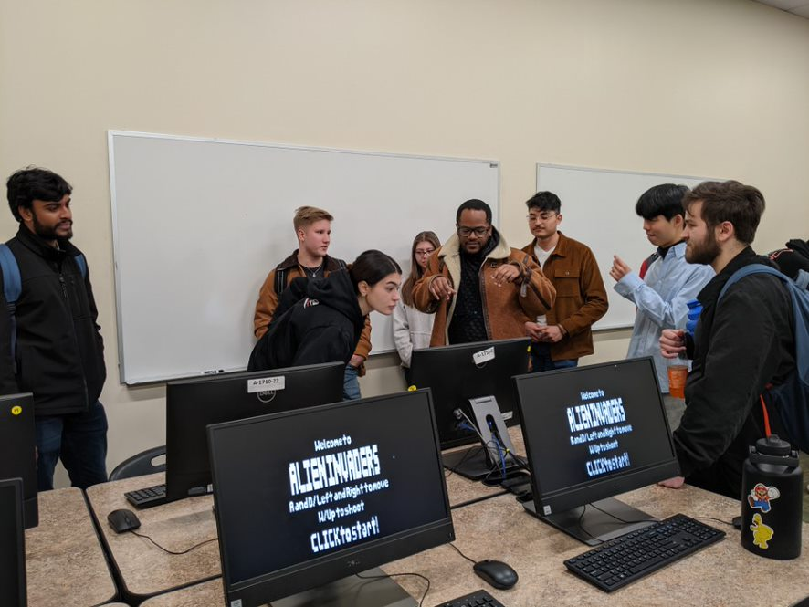
TAP Expo
This event allows for students and faculty to see the different tech-based designs and games that TAP students have created.
This is an amazing opportunity to get other students interested in tech and show them what they are truly able to create while also allowing TAP students to get good feedback on their work.
This event also allows for students to get to know others interested in tech as well as different tech professors.

Slide 9
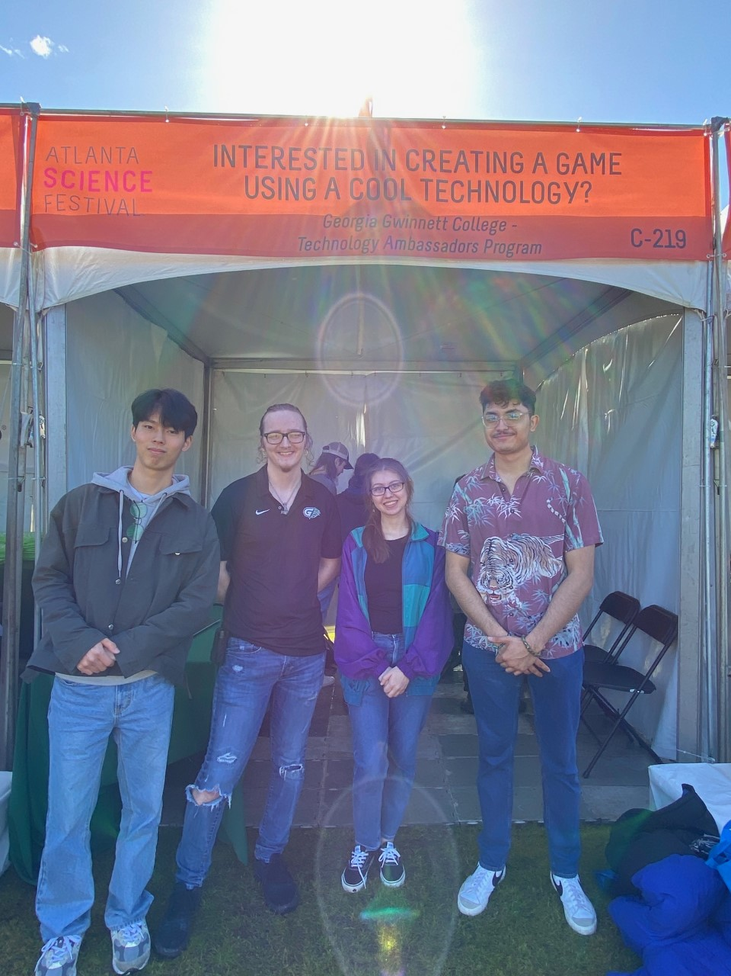
Atlanta Science Festival
At the Atlanta Science Festival, we did much of what was done at TAP Expo, getting people in our booth, getting people interested in programming and what it can do.
We got interest from lots of different people in all subject areas. It was a great time for everyone.

Slide 10

What is Processing?
We built our project using Processing. So what is it?
Processing began as a JDK language, or Java Development Kit. It is more of its own thing after Processing 4, but it still uses Java as its base language. More simply, Processing is a software ‘sketchbook’, used for easy Java introduction with a focus for learning and prototyping different code, making a game very simple to produce.

Slide 11
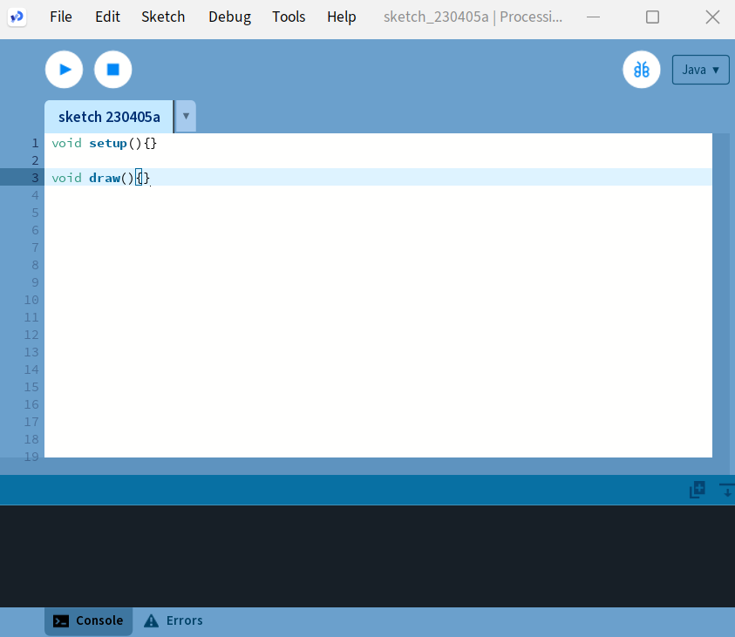
Processing Basics
Processing needs at least two functions to properly work.
The void setup() and the void draw()
The setup() only runs once and is where variables are initialized. The draw() function is different due to it continuously updating allowing for objects to be animated.
Add these two functions into processing

Slide 12
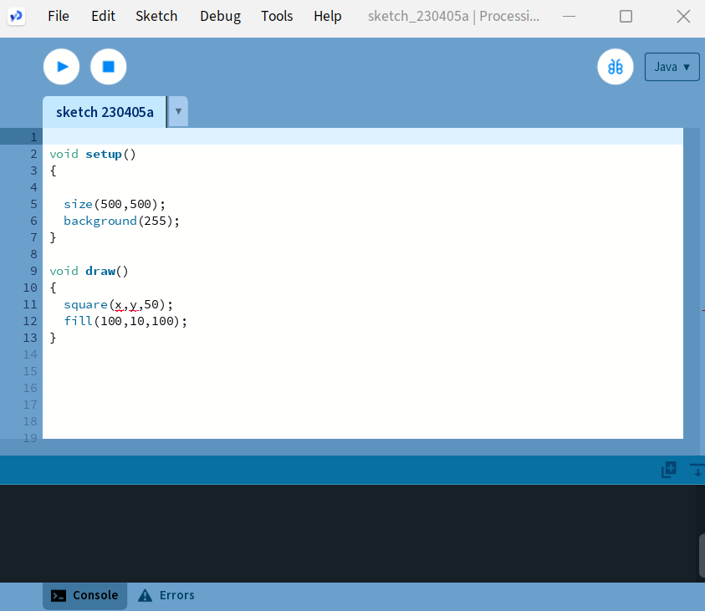
Processing Basics
Creating the screen is very important since that is where you will see everything you create!
Inside the setup() function add:
size(500,500);
background(255);
Don't forget the ;
Next you are going to want to add an object onto the screen!
Inside the draw() function add:
square(x,y,50);
fill(100,10,100):

Slide 13
Parameters and Arguments
What are parameters?
Parameters are variables that define a value during a function definition.
Example:
fill(R,G,B);
The fill() function, in processing can, uses the rgb color model.
R = red; G = green; B = blue
As you can see, functions can contain multiple parameters. These, however must be separated by commas.
What are arguments?
Arguments are values passed to a function whenever the function is called.
Example:
fill(100,10,100);
Try putting this into your processing program.
What color is it?
Feel free to mess around with the values.

Slide 14
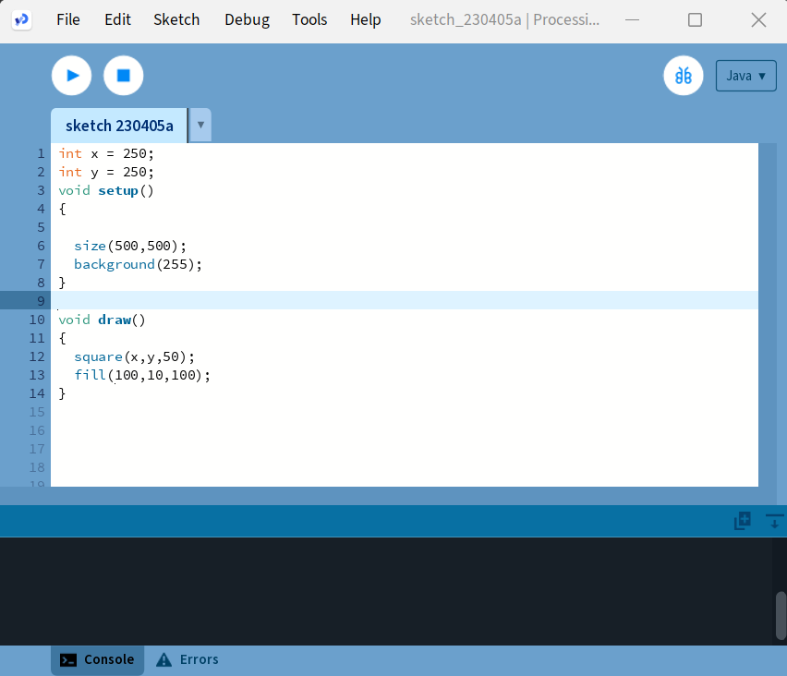
Processing Basics
Those x and y values must be store somewhere! Above the void setup() store the values by adding:
int x = 250;
int y = 250;
The square should now appear on your screen!
Add two more value under those called:
boolean lPressed = false;
boolean rPressed = false;
It should look like this!

Slide 15
What is an ‘if’ statement?
An ‘if’ statement is a way to check something. It returns what’s called a boolean, or a true/false.
For example:
x=2;
if (x>1):
return True;
This would return True. We could then use that True return to trigger other things in the program.
We used these in the processing basics to check if a certain key is pressed for movement. We can use it to trigger other events as well.
If statements are incredibly useful, and interesting to play with. Like the ‘truthiness’ of various objects.
Notes:
Truthiness! In python, an empty list is False, but a list with values in it are True, even if every value in the list is False, the list itself is True

Slide 16
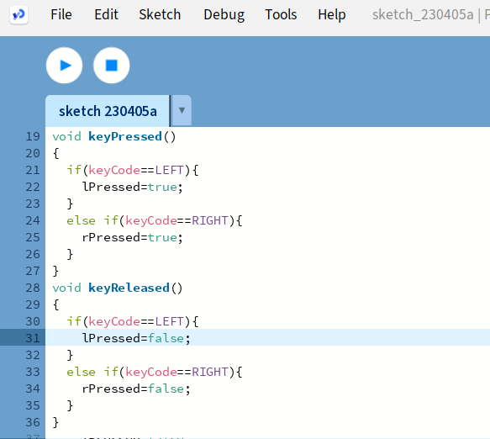
Processing Basics
Try and add keyReleased(){} on your own, but if you need help look here!
Let's add movement!
We need two new functions for this. Under the draw() add,
void keyPressed(){} and void keyReleased(){}
Inside the keyPressed() add an if statement
if(keyCode==LEFT){
lPressed = true;
}
else if(keyCode ==RIGHT){
rPressed=true;
)

Slide 17
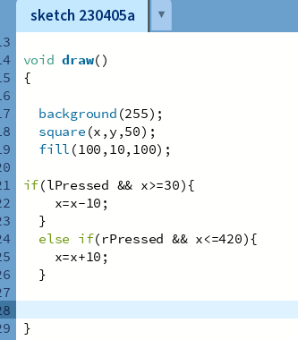
Processing Basics
After you finish, see what happens!
Finally, let's make it to were the square can travel along the x axis. Inside the draw() function add:
if(lPressed && x>=30){
x=x-10;
}
else if(rPressed && x<=420){
x=x+10;
}
It's important to add values less or greater than x to make sure the square stays inside the boundaries.

Slide 18
Time to Make a Game
Let’s take what we just did, and turn it around to make our game.
Go to our Starter Code!

Slide 19
What is a Class?
In the simplest terms, a class is code for creating and manipulating objects.
An object is the core of Object-Oriented Programming.
Java, C++, C#, JavaScript, and Python are some common object-oriented programming languages.
What is Object-Oriented Programming?
It is a method of programming based around creating and manipulating objects.

Slide 20
How do we use Classes?
In our project, we use classes to overall simplify code and prevent us from unnecessarily repeating dozens of lines of code.
We have a class for the Player, for Enemies, and Bullets, because all of these are objects we use for our game to be played.

Slide 21
More on ITEC
ITEC 2140 - Programming Fundamentals
and ITEC 2150 - Intermediate Programming
Go into classes, methods, and making more complex programs.
As you may know, GGC and its majors are focused on practicality, and this is true in the structure of their programs.
Each class builds well on top of the last.
What we made may appear daunting, but it is just made of a bunch of simple, small pieces put together.

Slide 22
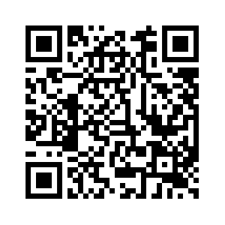
Closing
Time for questions!
Any questions about our major, classes we’ve taken, about our ITEC field in general, our experience in TAP and anything else you may be curious about?
This is also the time to take our
Post Survey

